Slide 1
OBJECT-ORIENTED PROGRAMMING USING JAVA
Vivek Ananta Taware
S.Y. B. Tech (Computer Engineering)
SHRIRAM INSTITUTE OF ENGINEERING AND TECHNOLOGY (POLY), PANIV
OBJECT-ORIENTED PROGRAMMING USING JAVA

Slide 2

agenda
INTRODUCTION
SCOPE OF PROJECT
USE OF TECHNOLOGY
ADVANTAGES AND DISADVANTAGES
CONCLUSION
OBJECT-ORIENTED PROGRAMMING USING JAVA

Slide 3

INTRODUCTION
Java was originally developed by James Gosling at Sun Microsystems. It was released in May 1995 as a core component of Sun's Java platform.
Java is a high-level, class-based, object-oriented programming language that is designed to have as few implementation dependencies as possible
It is a general-purpose programming language intended to let programmers write once, run anywhere (WORA),[16] meaning that compiled Java code can run on all platforms that support Java without the need to recompile.
OBJECT-ORIENTED PROGRAMMING USING JAVA

Slide 4
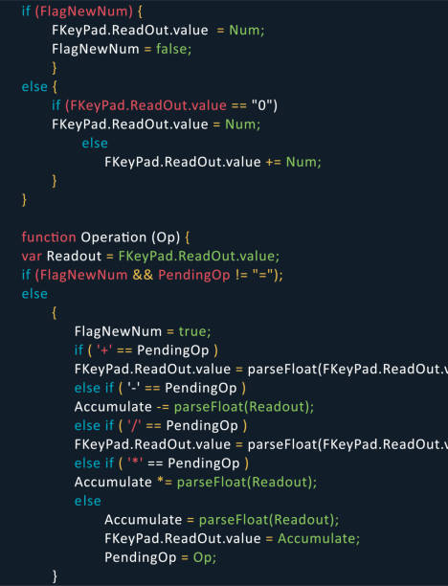
Scope Of Project
Java Platform, Micro Edition (Java ME) – targeting environments with limited resources.
• Java Platform, Standard Edition (Java SE) – targeting workstation environments.
• Java Platform, Enterprise Edition (Java EE) – targeting large distributed enterprise or Internet environments
OBJECT-ORIENTED PROGRAMMING USING JAVA

Slide 5
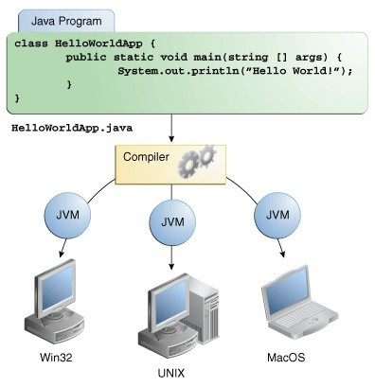
CONTROL FLOW
OBJECT-ORIENTED PROGRAMMING USING JAVA

Slide 6
Use of Technology
• Android Java is a core component of the Android operating system, which powers the majority of smartphones globally.
• Machine learning and data science Java is a popular language for these applications.
• Web applications Java is a framework for developing web applications, which are a foundation for digital businesses.
• Enterprise applications Java application servers are used to deploy enterprise applications, providing functions like security, transaction management, and scalability.
• Platform independence Java is platform independent because the Java compiler turns code into Java bytecode, which can run on any Java virtual machine (JVM).
• Java Development Kit (JDK) The JDK is a distribution of Java technology that includes a compiler, a virtual machine, and other utilities.
OBJECT-ORIENTED PROGRAMMING USING JAVA

Slide 7
Requirement
• JDK The JDK includes the Java Runtime Environment (JRE), which is required to run Java applications. The JDK also includes development tools like the Java compiler.
• RAM A laptop with at least 8 GB of RAM is recommended for running heavy IDEs and virtual machines.
• Processor A faster processor, like an Intel Core i5, is recommended for handling large projects and multiple applications
OBJECT-ORIENTED PROGRAMMING USING JAVA

Slide 8

Advantages
• java is simple language. Java does not support POINTERS.
• Java is first language in which programs can be executed using web.
• Write once run anywhere(WORA)
OBJECT-ORIENTED PROGRAMMING USING JAVA

Slide 9
Disadvantages
• Slow performance.
• No support for low level programming.
• Poor features in java. No control over Garbage collection
OBJECT-ORIENTED PROGRAMMING USING JAVA

Slide 10
Conclusion
Java is a versatile and powerful programming language that is likely to continue to be a significant part of the programming
world: Ease of use: Java is easy to learn and write code in because it's an object-oriented language.
Platform independence: Java's platform independence allows programs to be deployed across multiple devices and operating systems.
Speed and performance: Java is known for its speed and performance, making it a good choice for high-performance applications.
Security features: Java's security features make it a good choice for developers of all skill levels.
Teaching language: Java is a good teaching language because it allows students to learn object-oriented programming without the complexity of C++.
Community of developers: Java has a large community of developers. Ability to adapt: Java has the ability to adapt and integrate with new technologies
OBJECT-ORIENTED PROGRAMMING USING JAVA

Slide 11
References
Java has a huge standard library (The Java API). • From now on, your primary reference shall be:
➢ http://docs.oracle.com/javase/7/docs/api/ Very useful tutorials: Java Language:
➢ http://docs.oracle.com/javase/tutorial/java/index.html Other concepts (Network, concurrency, graphics …)
➢ http://docs.oracle.com/javase/tutorial/
➢ Vivek Taware github:/vivektaware0505:Github/https://www.linkedin.com/in/vivekta ware085476241?utm_source=share&utmcampaign=sharevia&utmcon tent=profile&utm_medium=androidap
OBJECT-ORIENTED PROGRAMMING USING JAVA

Slide 12

Thank you
OBJECT-ORIENTED PROGRAMMING USING JAVA

